Slide 1
November 2020
New Paltz, NY Flood Risk:
Present and Future Under Climate Change
Woodwell Climate Research Center
Notes:
Photo: https://unsplash.com/photos/-N_UwPdUs7E

Slide 2
Originally founded as the Woods Hole Research Center in 1985, the organization was established to put the insights of climate science into the hands of decision makers.

Slide 3
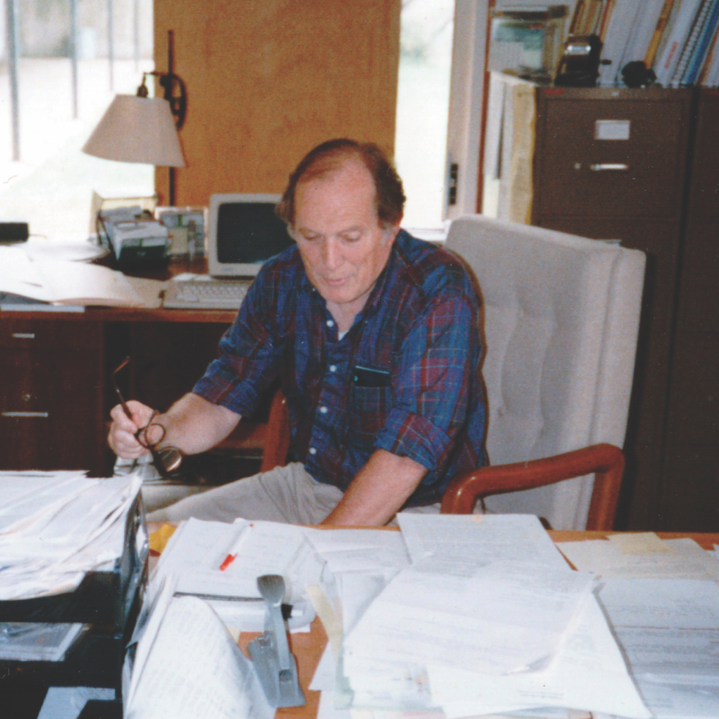
Timeline
1985
Woodwell founded to advance science-based climate decision-making and policies.
1986
Woodwell among first to testify to Congress about dangers of climate change
1990
Helped design and develop the UNFCCC and REDD+
2007
Woodwell scientists shared 2007 Nobel Prize awarded to the IPCC
2009
Woodwell President Dr. John Holdren hired to serve as President Obama’s science advisor
2015
Woodwell President Dr. Phil Duffy hired to lead the organization
Founder, Dr. George Woodwell

Slide 4
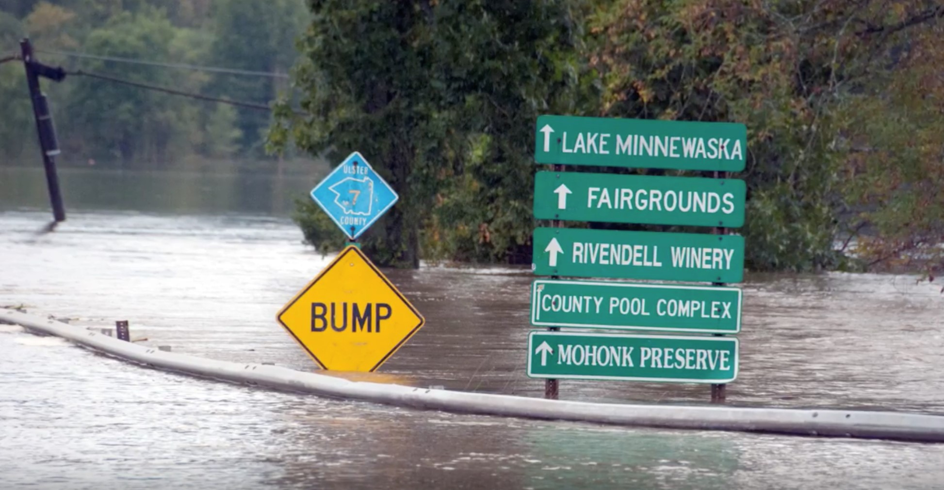
Climate change risk is no longer a future problem.
The physical impacts of a changing climate are being observed now, and will increase in the coming decades.
The impacts of climate change on frequency and severity of physical hazards will put many communities at risk. Flooding is one such hazard, driven by increased precipitation and sea level rise.
This photo depicts flooding in New Paltz, NY that occurred as a result of Hurricane Irene in August, 2011.
Photo Credit: Katy Silberger

Slide 5
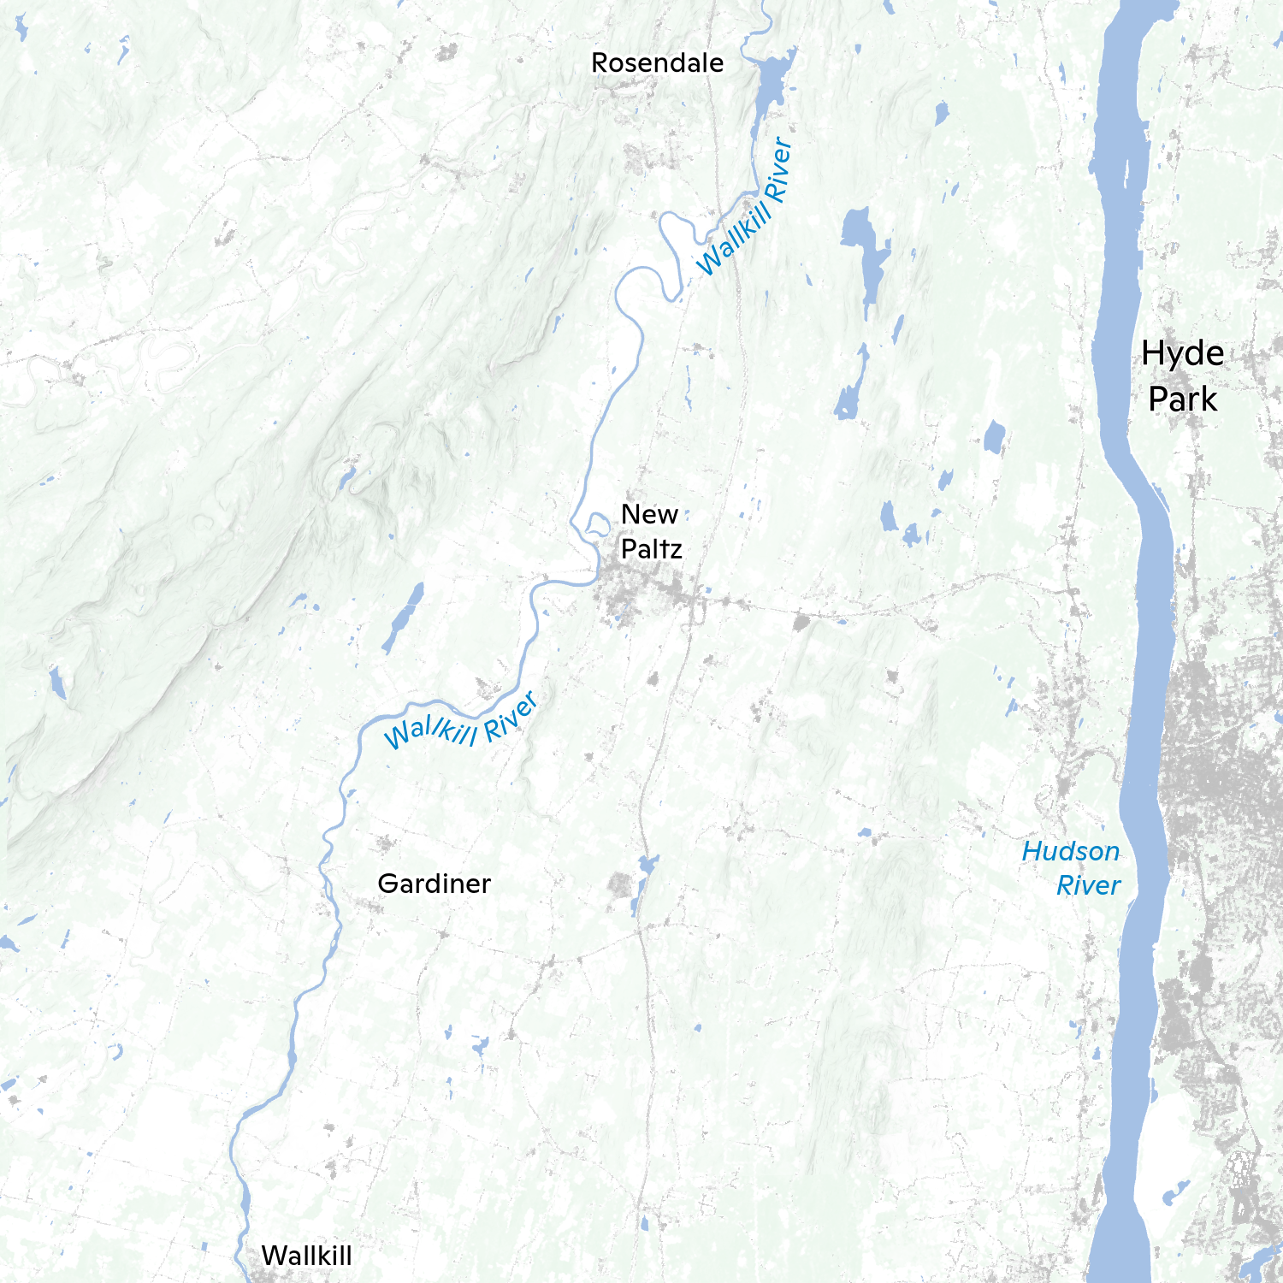
New Paltz is vulnerable to two types of flooding.
Riverine Flooding
Pluvial Flooding
Riverine (also known as fluvial) flooding occurs when rivers exceed the boundaries of the river channel.
Pluvial flooding usually occurs when a stormwater system or soils cannot effectively drain or infiltrate rainfall, leading to standing water. It is not associated with riverine flooding.
Source: https://onlinelibrary.wiley.com/doi/full/10.1002/wat2.1401

Slide 6
Flood Model Methodology
Elevation
LiDAR (7m)
Rainfall
NOAA NA14 Atlas
Streamflow
USGS Stream Gage
Infiltration Rate
USGS SSURGO soil database
Land Friction
National Land Cover Dataset

Slide 7
Flood Model Methodology
Elevation
LiDAR (7m)
Rainfall
NOAA NA14 Atlas
Streamflow
USGS Stream Gage
Flood Model
LISFLOOD-FP
Infiltration Rate
USGS SSURGO soil database
Land Friction
National Land Cover Dataset

Slide 8
Flood Model Methodology
Elevation
LiDAR (7m)
Rainfall
NOAA NA14 Atlas
24 hour simulation
Maximum flood extent
Maximum flood depth
Flood extent/depth at 20 min interval
Streamflow
USGS Stream Gage
Flood Model
LISFLOOD-FP
Infiltration Rate
USGS SSURGO soil database
Land Friction
National Land Cover Dataset

Slide 9
Results

Slide 10
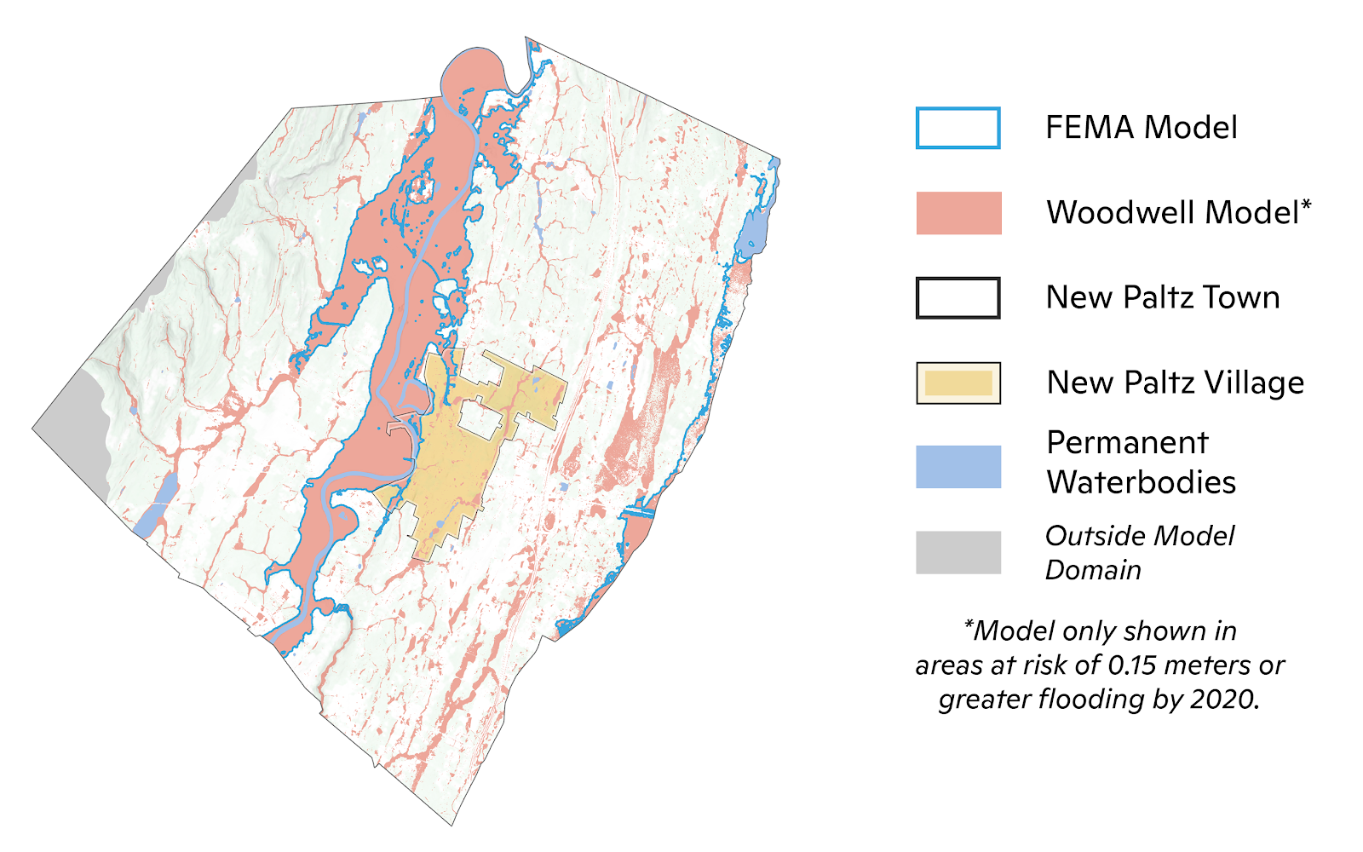
Present 1-in-100 Year Flood: Woodwell vs. FEMA
The flood extent generated by Woodwell is overall greater than FEMA’s.
These discrepancies mainly occur because:
FEMA does not consider pluvial flooding and focuses on riverine events
Small streams are not modeled by FEMA
While the current effective flood maps from FEMA for Ulster County were published in 2016, the hydrologic analysis used in the creation of the maps dates from 1984 and has not been updated.
FEMA only shows historical flood risk and does not incorporate future changes in the climate.

Slide 11
Future Rainfall and Streamflow Events
 | 2041-2060 | 2071-2090
1-in-100 year | 1-in-67 year 1.5x as likely | 1-in-25 year 4x as likely
1-in-500 year | 1-in-285 year 1.8x as likely | 1-in-86 year 5.8x as likely
How to Interpret:
In the year 2071-2090, what is today considered a 1-in-100 year rainfall event will become a 1-in-25 year storm, indicating it is 4x as likely to occur.
Rainfall
Future return period of historical (2001-2020) rainfall events
 | 2041-2060 | 2071-2090
1-in-100 year | 1-in-51 year 2x as likely | 1-in-27 year 3.7x as likely
1-in-500 year | 1-in-144 year 3.5x as likely | 1-in-66 year 7.6x as likely
Streamflow
Future return period of historical (2001-2020) streamflow events

Slide 12
Future Flood Extents and Building Damage
 | 2041-2060 | 2071-2090
1-in-100 year | + 7.2% | + 20.2%
1-in-500 year | + 4.8% | + 14.1%
How to Interpret:
In the year 2071-2090, the flood area for what is today considered a 1-in-100 year storm will be 20.2% greater.
% Change in Flood Area
Changes in flood extent from present period.
 | 2041-2060 | 2071-2090
1-in-100 year | + 13cm 0.43ft | + 35cm 1.14ft
1-in-500 year | + 30cm 0.99ft | + 45cm 1.47ft
Change in Average Water Depth
Changes in average flood depth from present period.

Slide 13
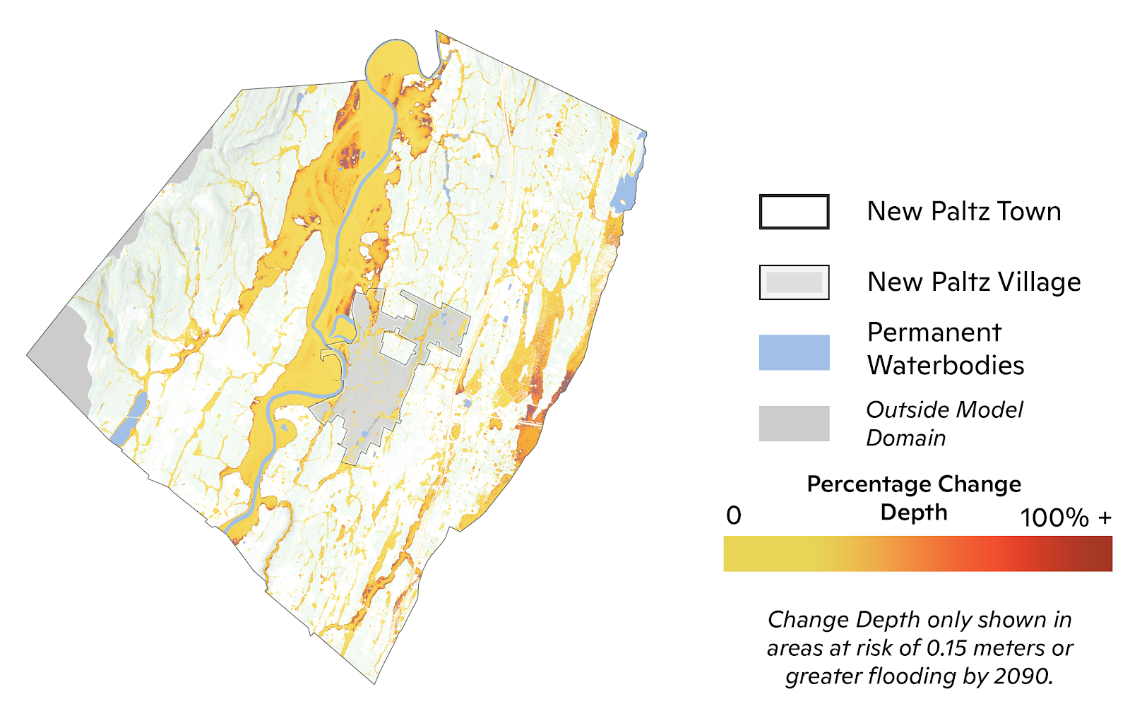
Change in Average Water Depth
Map shows percent change in water depth between 2041-2060 and present 1-in-100 year event.
 | 2041-2060 | 2071-2090
1-in-100 year | + 13cm 0.43ft | + 35cm 1.14ft
1-in-500 year | + 30cm 0.99ft | + 45cm 1.47ft
Notes:
100yr 2041-2061 Percent Change Depth

Slide 14
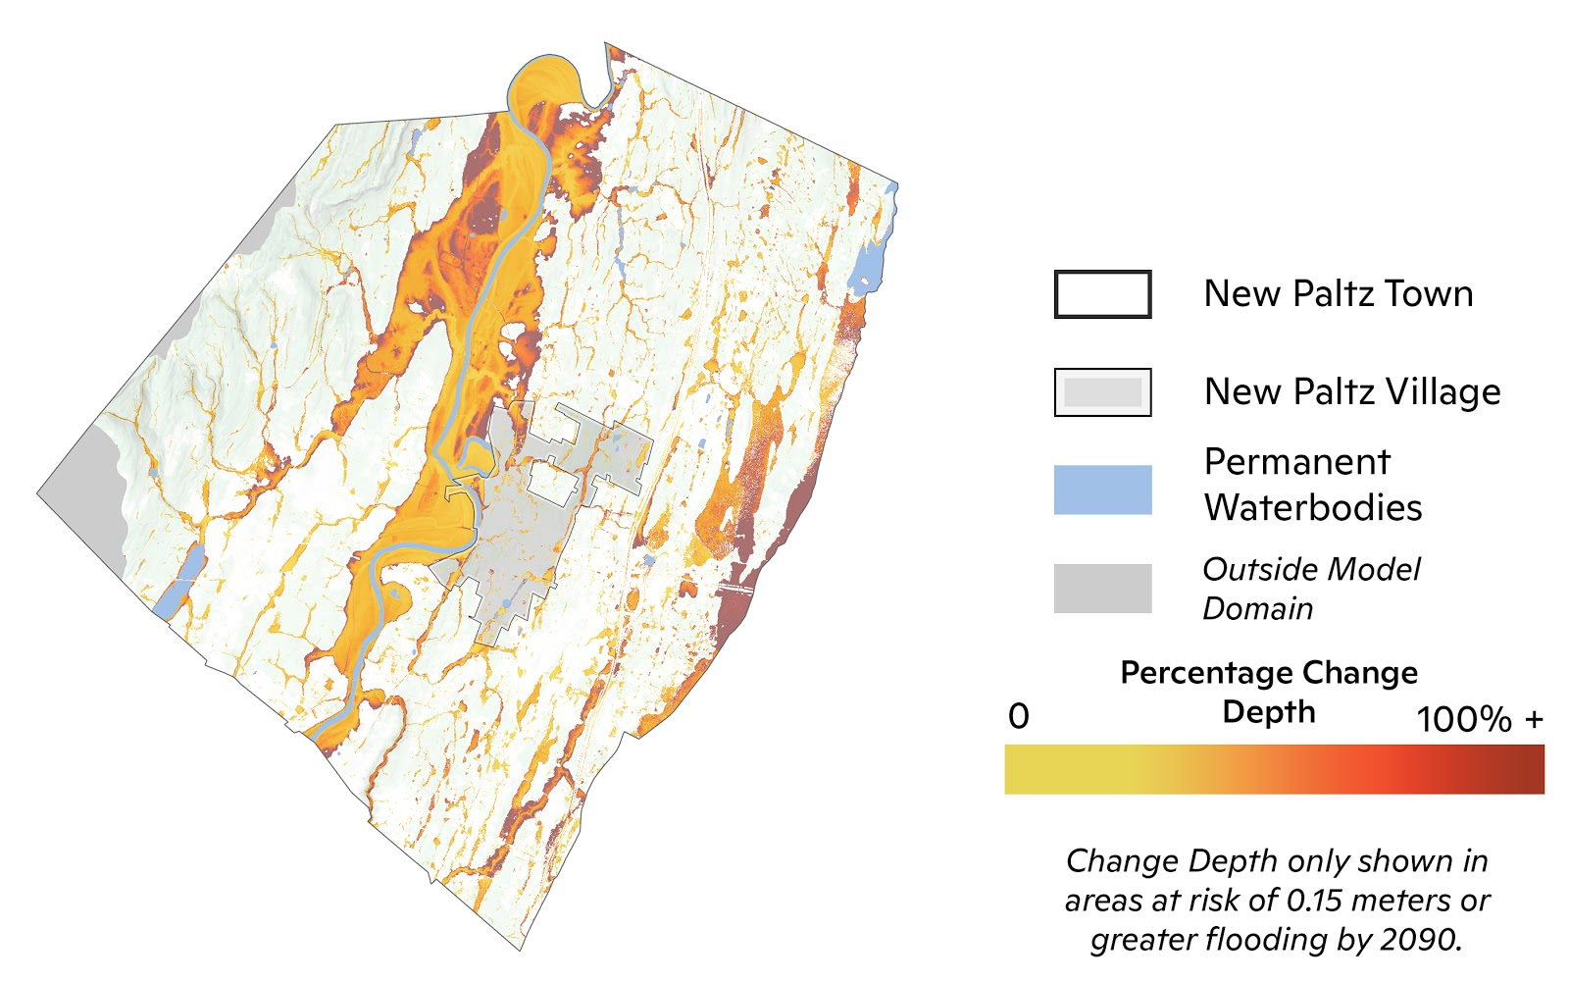
Change in Average Water Depth
Map shows percent change in water depth between 2071-2090 and present 1-in-100 year event.
 | 2041-2060 | 2071-2090
1-in-100 year | + 13cm 0.43ft | + 35cm 1.14ft
1-in-500 year | + 30cm 0.99ft | + 45cm 1.47ft
Notes:
100yr 2071-2090 Percent Change Depth

Slide 15
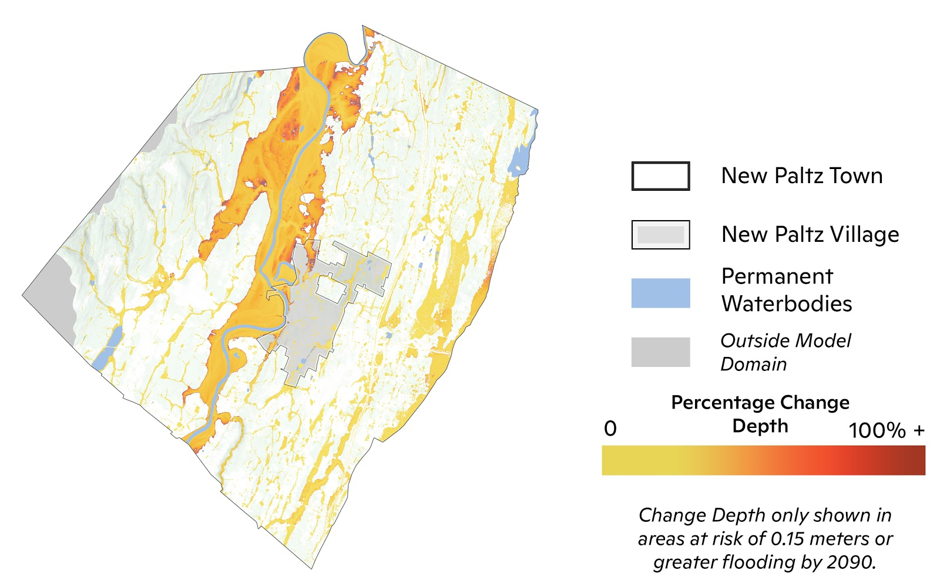
Change in Average Water Depth
Map shows percent change in water depth between 2041-2060 and present 1-in-500 year event.
 | 2041-2060 | 2071-2090
1-in-100 year | + 13cm 0.43ft | + 35cm 1.14ft
1-in-500 year | + 30cm 0.99ft | + 45cm 1.47ft
Notes:
500yr 2041-2061 Percent Change Depth

Slide 16
Change in Average Water Depth
Map shows percent change in water depth between 2071-2090 and present 1-in-500 year event.
 | 2041-2060 | 2071-2090
1-in-100 year | + 13cm 0.43ft | + 35cm 1.14ft
1-in-500 year | + 30cm 0.99ft | + 45cm 1.47ft
Notes:
500yr 2041-2061 Percent Change Depth

Slide 17
Number of Buildings at Risk
 | 2001-2020 (Historical Period) | 2041-2060 | 2071-2090
1-in-100 year | 957 | 1,071 +12% | 1,282 +34%
1-in-500 year | 1,295 | 1,394 +8% | 1,589 +23%
How to Interpret:
In the year 2071-2090, the number of buildings that will be affected by at least 15cm (6in) of flooding during today’s 1-in-100 year storm will increase by 34% (1,282 buildings, compared to 957 buildings).
Affected Buildings
Number of buildings in model domain flooded (water depth greater than 15 cm).

Slide 18
Conclusion
Inland floods are some of the most devastating natural disasters and are expected to worsen under climate change due to the intensification of extreme precipitation.
New Paltz, NY will be impacted by increased riverine and pluvial flood risk, and the community should make future planning decisions with these results in mind.
Regulatory flood maps for New Paltz should incorporate future flood risk to prevent underestimation of flood exposure
Animation shows water depth for a 1-in-100 year event between 2071-2090, over a 24 hour time period.

Slide 19
Summary
Inland floods are some of the most devastating natural disasters and are expected to worsen under climate change due to the intensification of extreme precipitation.
In this study, present and future flood risk in New Paltz, NY, is examined through changes in the 1-in-100 year and 1-in-500 year flood events. Future rainfall and streamflow are estimated for two time periods, 2041-2060 and 2071-2090 representing the mid and late 21st century, respectively, using a regional climate model and river-reach scale hydrologic model.
The output of these simulations show that the historical 100-year rainfall event is 1.5x and 4x as likely in 2041-2060 and 2071-2090, respectively. The historical 100-year streamflow event is 2x and 3.7x as likely in 2041-2060 and 2071-2090, respectively. Greater changes in frequency were calculated for the 500-year rainfall and streamflow events.
Using these estimates as inputs into a flood model reveal significant increases in flood risk across New Paltz. The total inundated area for the 100-year event within the flood model domain increases by 7% and 20% by mid and late 21st century, respectively. The number of buildings inundated by the 100-year event increases by 12% and 34% by the mid and late 21st century, respectively. These metrics also increase in the future periods for the 500-year event but the changes are smaller in magnitude.

Slide 20
Contact
Dr. Christopher Schwalm
Risk Program Director, Associate Scientist
cschwalm@woodwellclimate.org
Notes:
Photo: https://unsplash.com/photos/-N_UwPdUs7E

Slide 21
Appendix

Slide 22
Methodology Overview: Extreme Rainfall and Streamflow
Future Rainfall
Future Streamflow
Calculate change in probability of extreme event (e.g. 100 year) from present period (2000-2021) to future periods (2041-2060), (2071-2090) assuming RCP8.5
Associate future extreme event probability with historical, observed rainfall value
Extract the cell value for the New Paltz watershed
Extract New Paltz/Wallkill River reach from ~57,000 modeled river reaches
Calculate change in probability of extreme event (e.g. 100 year) from present period (2000-2021) to future periods (2041-2060), (2071-2090) assuming RCP8.5
Associate future extreme event probability with historical, observed streamflow value
Regional Climate Model – REMO2015 ~22km resolution

